Slide 1

Python for Scouting and Data Analysis Issaquah Robotics Society
FRC 1318
Stacy Irwin
June 2017

Slide 2
About this Course
Objectives: participants who complete this course will be able to:
Revise, extend, maintain, and operate the IRS’s scouting system
Analyze FRC data and present results
Use Python for other scientific or engineering projects
Prerequisites
None
Necessary materials
Laptop
Preferably Windows 10 because that’s what the instructor uses
But any operating system should work
No books needed -- all necessary reference materials are online
Instructional method
Keep lectures to a minimum
Show participants the online references and provide just enough information to start working on the coding exercises
Provide encouragement when participants get stuck
Provide hints if they get really stuck

Slide 3
Getting Started
Session 1

Slide 4
Python Overview
One of the most popular computer programming languages, along with Java, C, and C++
First released in 1991
Open source and free to use
Designed for readability
Supports many different styles of programming, such as functional and object-oriented
Python is an interpreted language
Interpreted means program code is not compiled
Instead, text files with program code are read and executed by another program called the Python interpreter
Benefits of interpreted language
Programs can be run on any operating system (e.g., Linux, Windows, Mac, etc.)
Simpler development cycle since no compilation is required
Disadvantages
Computer must have interpreter installed to be able to run program
Programs do not execute as fast as compiled languages
Has nothing to do with snakes, named after a British comedy troupe
Sources:
https://en.wikipedia.org/wiki/Python_(programming_language)
https://www.python.org/
https://en.wikipedia.org/wiki/Monty_Python

Slide 5
Why the IRS Uses Python
Many excellent, free packages available in Python for data analysis, data access and retrieval, graphing, statistics, etc.
Relatively easy to learn (compared to C or Java)
Python programming is a valuable skill for all STEM majors (not just computer science). Python is an excellent tool for:
Statistical analysis via numpy and scipy packages
Symbolic mathematics via Sympy package
Writing technical reports via Jupyter Notebooks
And much more...
Slow speed due to being interpreted is not an issue - Python is plenty fast enough for our purposes
IRS uses the CPython implementation
Most common implementation
Written in C and can be extended with modules written in C or C++
The IRS uses Python 3
Python 2 will no longer be supported as of 1 January 2020

Slide 6
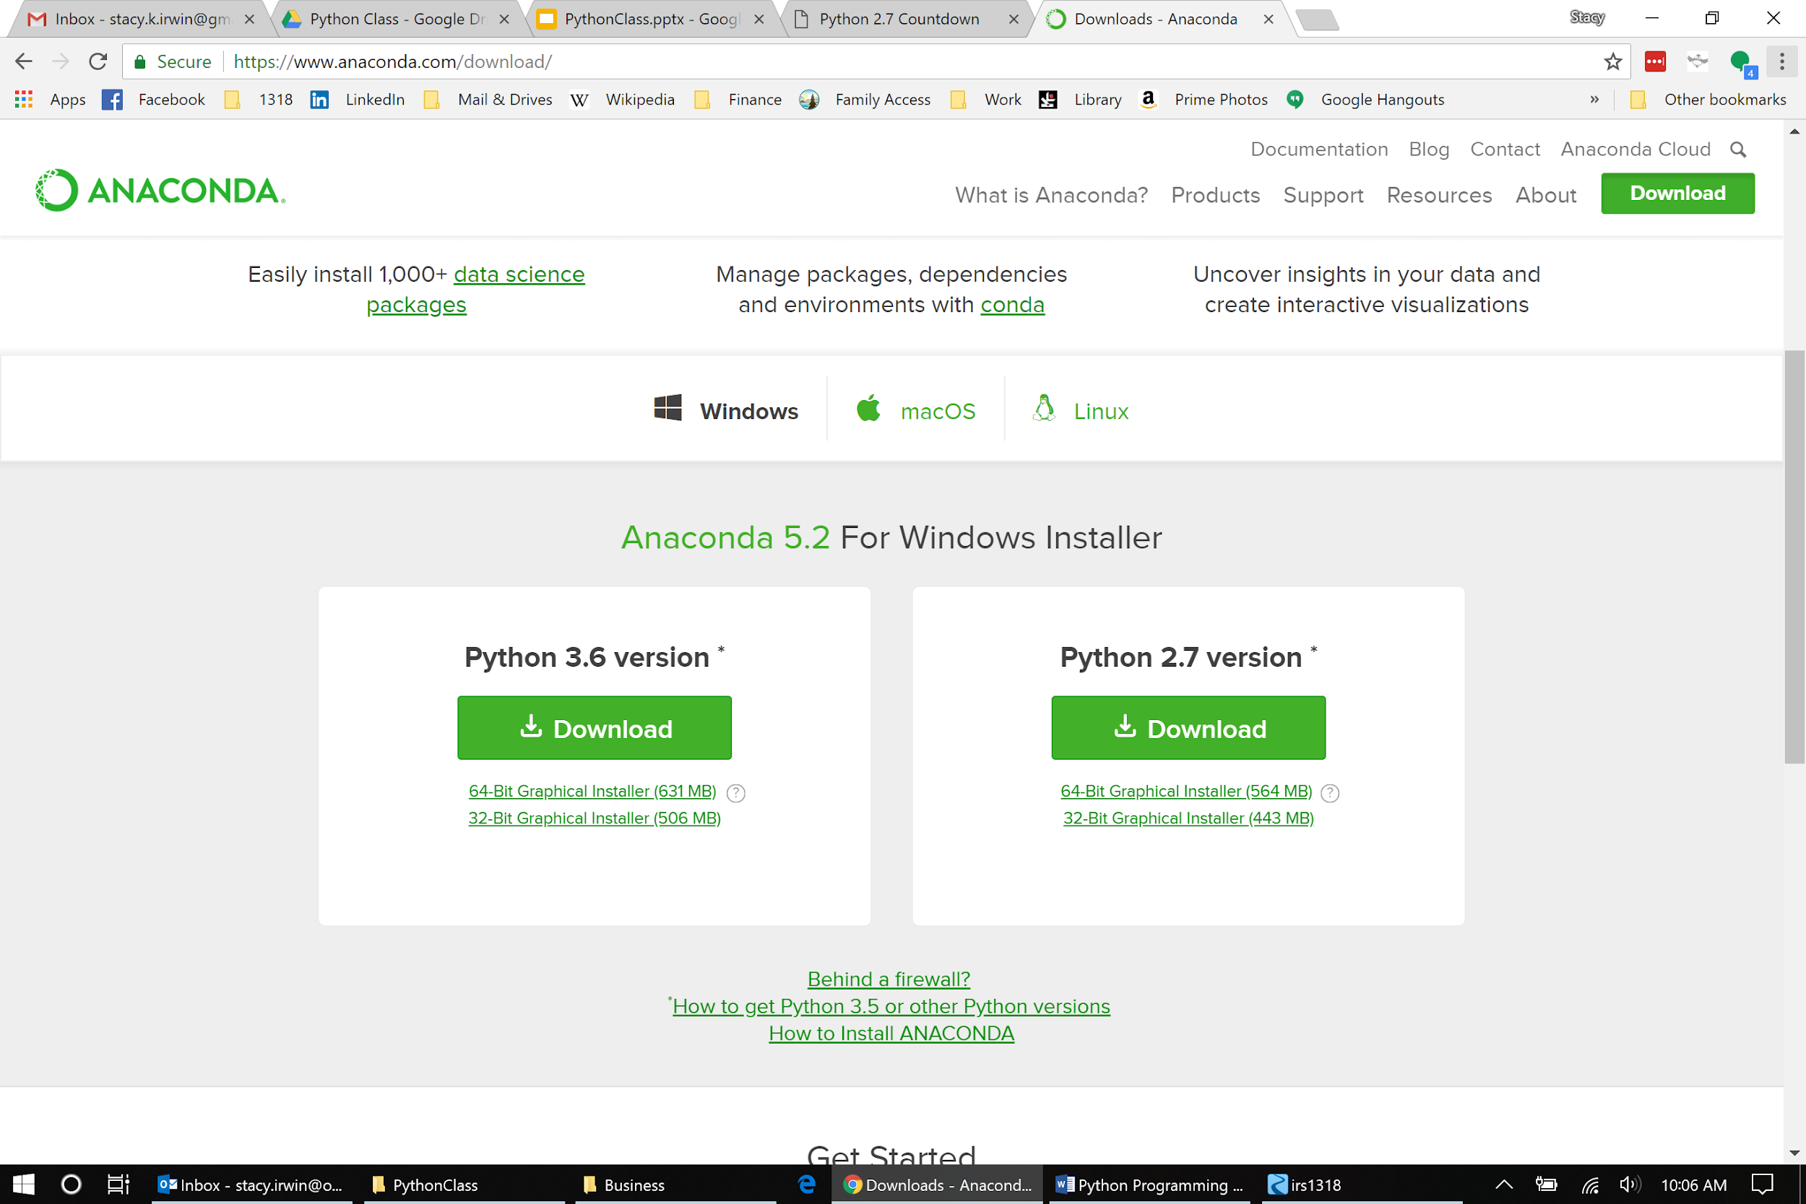
Installing Python on Windows 10
Before Installation
Make sure there are no spaces in your user folder on Windows (spaces can cause problems down the road)
Example (BAD): C:\Users\Stacy Irwin\
Example (GOOD): C:\Users\stacy
Install on a different account if your user account name contains a space
Uninstall all other versions of Python
Go to Add or Remove Programs
Search list of installed programs and uninstall anything with Python in the program name
Restart computer after uninstall
Many ways to install Python. The IRS uses the Anaconda3 version of CPython
Easy to install and includes almost all packages that the IRS uses for FRC scouting
Install from https://www.anaconda.com/download/
Install Python 3.6 version or newer
Installation Options:
Select “Install for this user only”
Does not require administrator login
All files will be installed to “C:\Users\{username}\Anaconda3
Accept all other default settings

Slide 7
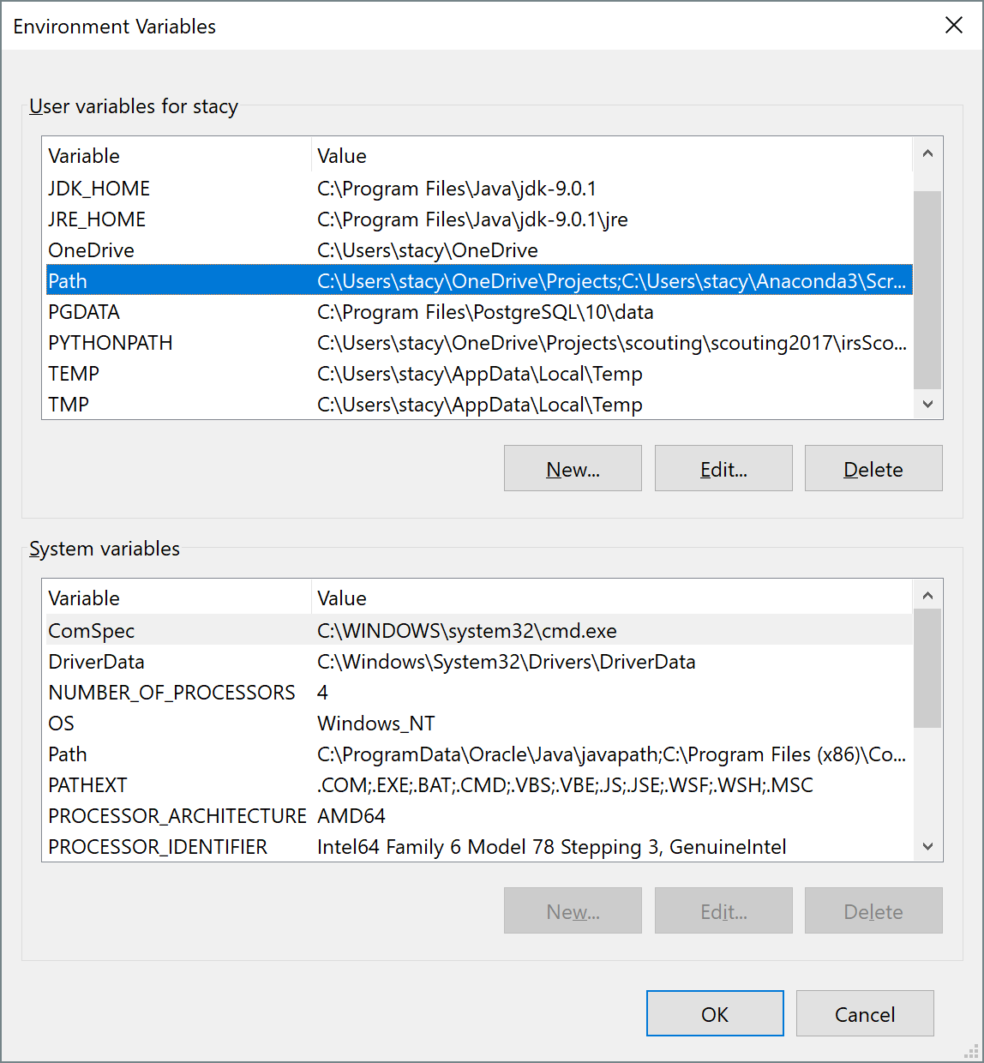
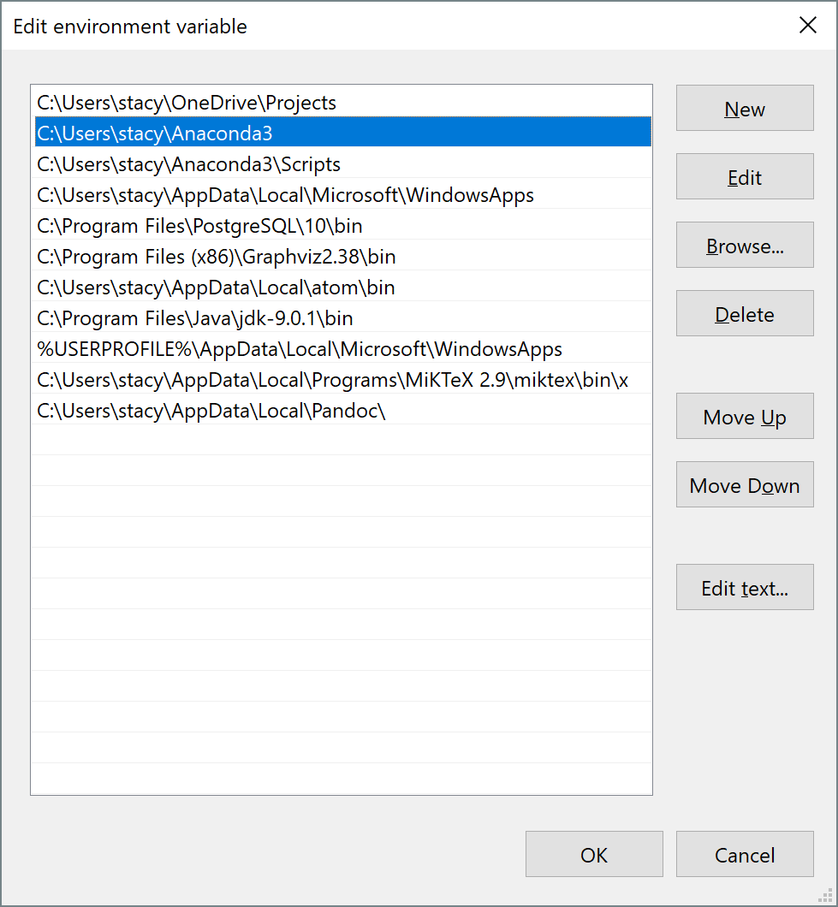
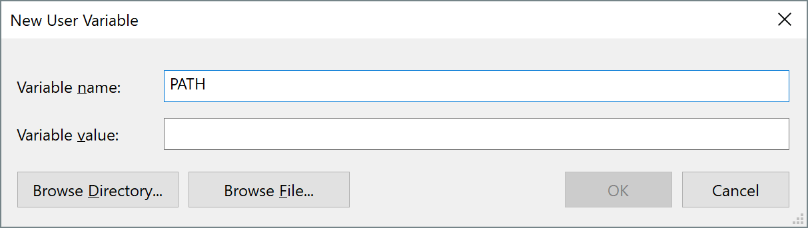
Configuration
Type env in the taskbar search box and select Edit the Environment variables for your account from search results.
Select the Path environment variable from upper list of environment variables and click Edit, or ...
If no Path variable listed, click New and add a Path variable
Path variable should include absolute paths to Anaconda3 and Anaconda3/Scripts folders
Separate folder paths with semicolons
Examples
C:\Users\{username}\Anaconda3
C:\Users\{username}\Anaconda3\Scripts
Save changes by clicking OK on all open dialogs
Dialog for adding new PATH variable (step #3)

Slide 8
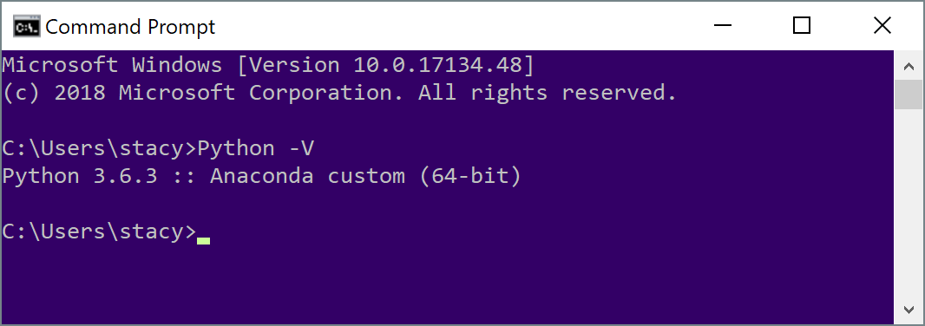
Verification
Type CMD in Windows search box
Select Command Prompt from search results
Type Python -V at command prompt. Should see something like this:
If you see something like ‘Python’ is not recognized …, then check your PATH variable

Slide 9
Session 1 Reading List
Reading Assignment
Python Tutorial
https://docs.python.org/3/tutorial/index.html
Sections 1 and 2
Windows Command Prompt
https://www.computerhope.com/issues/chusedos.htm
Windows Environment Variables
https://windowsreport.com/edit-windows-path-environment-variable

Slide 10
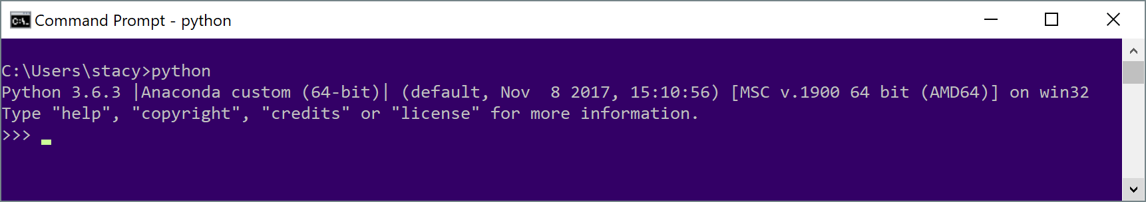
Session 1 Exercises - Python
Use the Python interpreter within the command window to complete the exercises on this slide
Type python at the command prompt to start the interpreter
Type quit()to close the interpreter and return to the windows prompt
Calculate the average finals score for the winners of each division at the Houston world championships (see https://www.thebluealliance.com/)
Calculate 13 to the 18th power
What is the remainder of 13 to the 18th power divided by 1318?

Slide 11
Useful Command Prompt Commands
help (Help)
help lists the built-in commands that are available at the command prompt.
help cd displays detailed documentation for the change directory command.
dir (Directory)
dir lists all subdirectories and files within the current directory.
dir *.txt lists all of the files ending in ".txt" within the current directory.
cd (Change directory)
cd Pictures changes the directory location to the pictures subdirectory within the current command prompt location.
cd .. moves to the parent directory of the current command prompt location.
cd C:/Program Files moves to the C:/Program Files folder, regardless of the current directory location.
md (Make Directory)
md new_folder creates a subdirectory named new_folder within the current directory.
rd (Remove Directory)
rd /S subfolder deletes the subdirectory subfolder, including erasing all files and subdirectories within subfolder.
del (Delete File)
del old_file.py deletes old_file.py in the current folder.
del *.txt* deletes all files ending in .txt in the current folder. Note the use of '*' as a wildcard.
copy (Copy File)
copy s*.* C:\Users\Stacy\Documents copies all files that start with 's' to the documents folder.
move (Move File)
move *s.docx C:\Users\Stacy\Documents moves all Microsoft Word files that end in 's' to the documents folder.
set (Displays and Sets Environment Variables)
set displays all environment variables
set {var_name} displays the environment variable var_name
cls (Clear Screen)
cls clears all text from the command window.
exit (Exit)
exit exits the command window.

Slide 12
Session 1 Exercises - Command Line
Create a folder using the command line
Using the command line, print the value of the PATH environment variable from the command line
Using only the command line, navigate from you Python project file to the root folder (C:/) and list the contents.

Slide 13
Data Types and Control Statements
Session 2

Slide 14
Session 2 Overview
Topics
Control statements, such as for loops and if statements
Data structures, including dictionaries and lists
Calling built-in functions
Using the Python Standard Library
Writing Code in Jupyter Notebooks
Allows you to write and run Python code within a web browser

Slide 15
Session 2 Reading List
Reading Assignment
Python Tutorial
https://docs.python.org/3/tutorial/index.html
Sections 3, 4.1 - 4.5, 7.2
Jupyter Notebooks
https://jupyter-notebook.readthedocs.io/en/stable/examples/Notebook/Notebook%20Basics.html
Notebook Basics section
JavaScript Object Notation (JSON)
http://www.json.org/
https://en.wikipedia.org/wiki/JSON

Slide 16
Session 2 Preparations
Create a folder in which to save the code you write
Make sure there are no spaces in the folder name or in the names of the parent folders
Download the following files from https://drive.google.com/open?id=1eAV6gEo4Z9B0qSD6UNGf6Zdt1UBHp6uI
sched_turing_2018.json
rank_turing_2018.json
Save them to the file you created on the previous slide

Slide 17
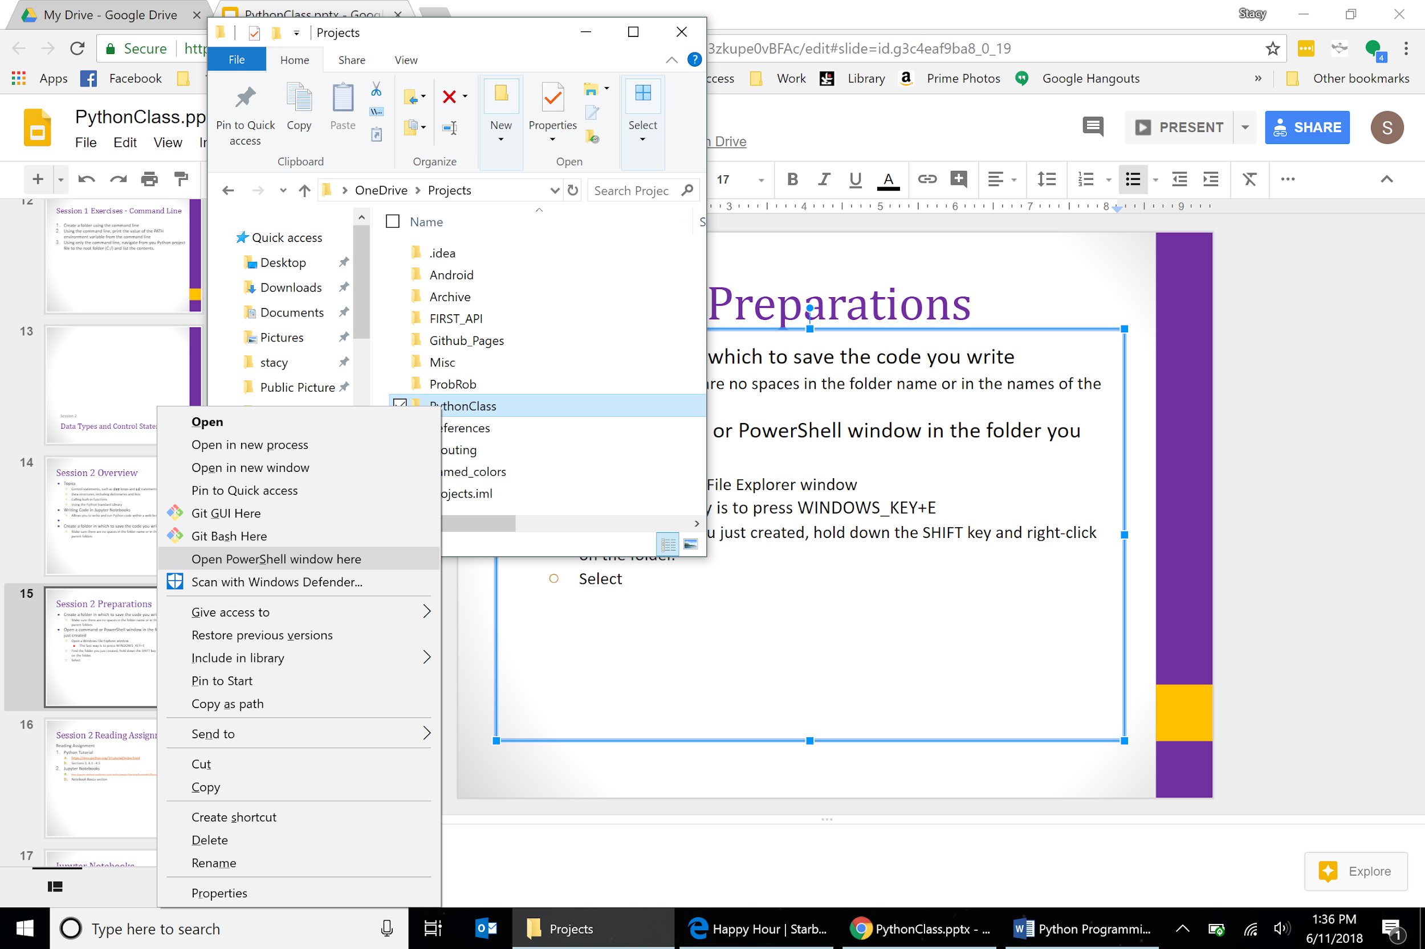
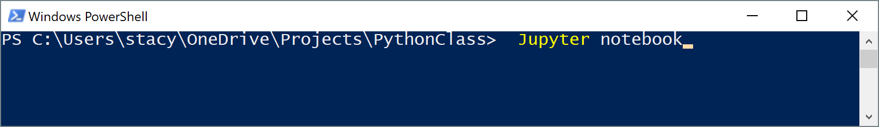
More Preparations
Open a PowerShell window in the folder you just created
Open a Windows File Explorer window
The fast way is to press WINDOWS_KEY+E
Find the folder you just created, hold down the SHIFT key and right-click on the folder.
Select Open PowerShell window here
At the PowerShell prompt:
Type jupyter notebook
Hit ENTER
Your browser should open after a few seconds
Check your path variable if you get a “... is not recognized…” error
Must contain …\Anaconda3\Scripts folder

Slide 18
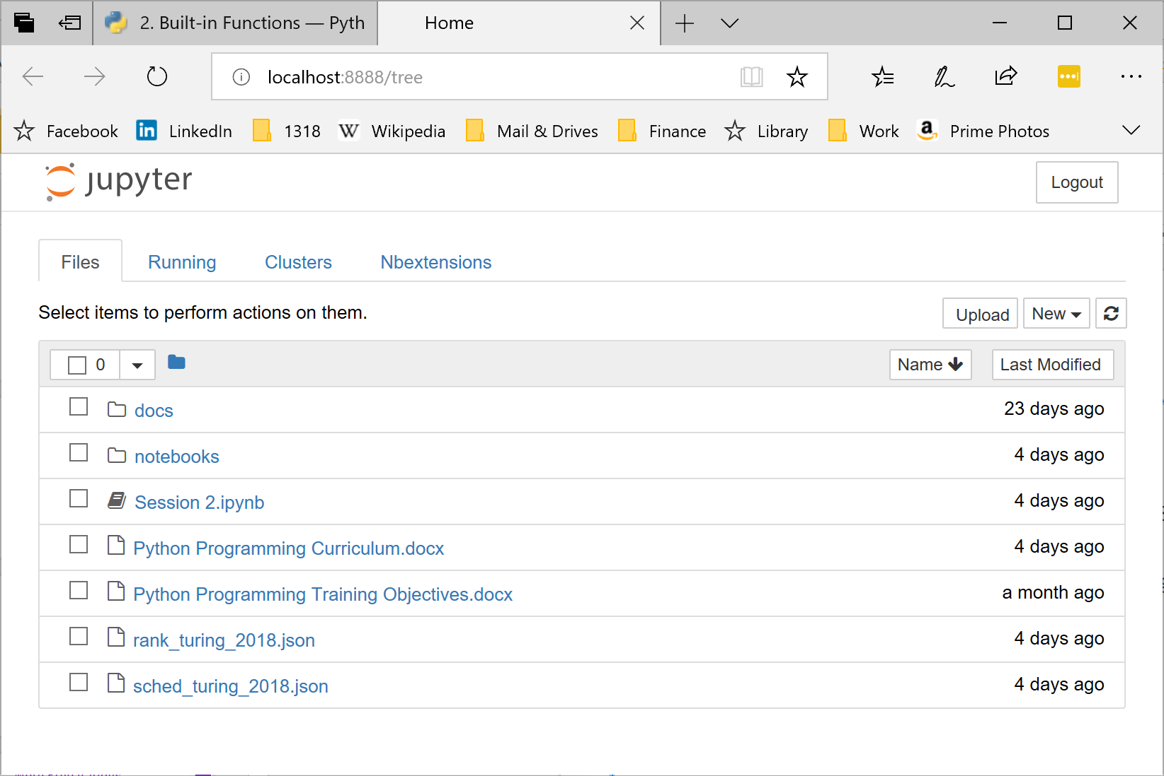
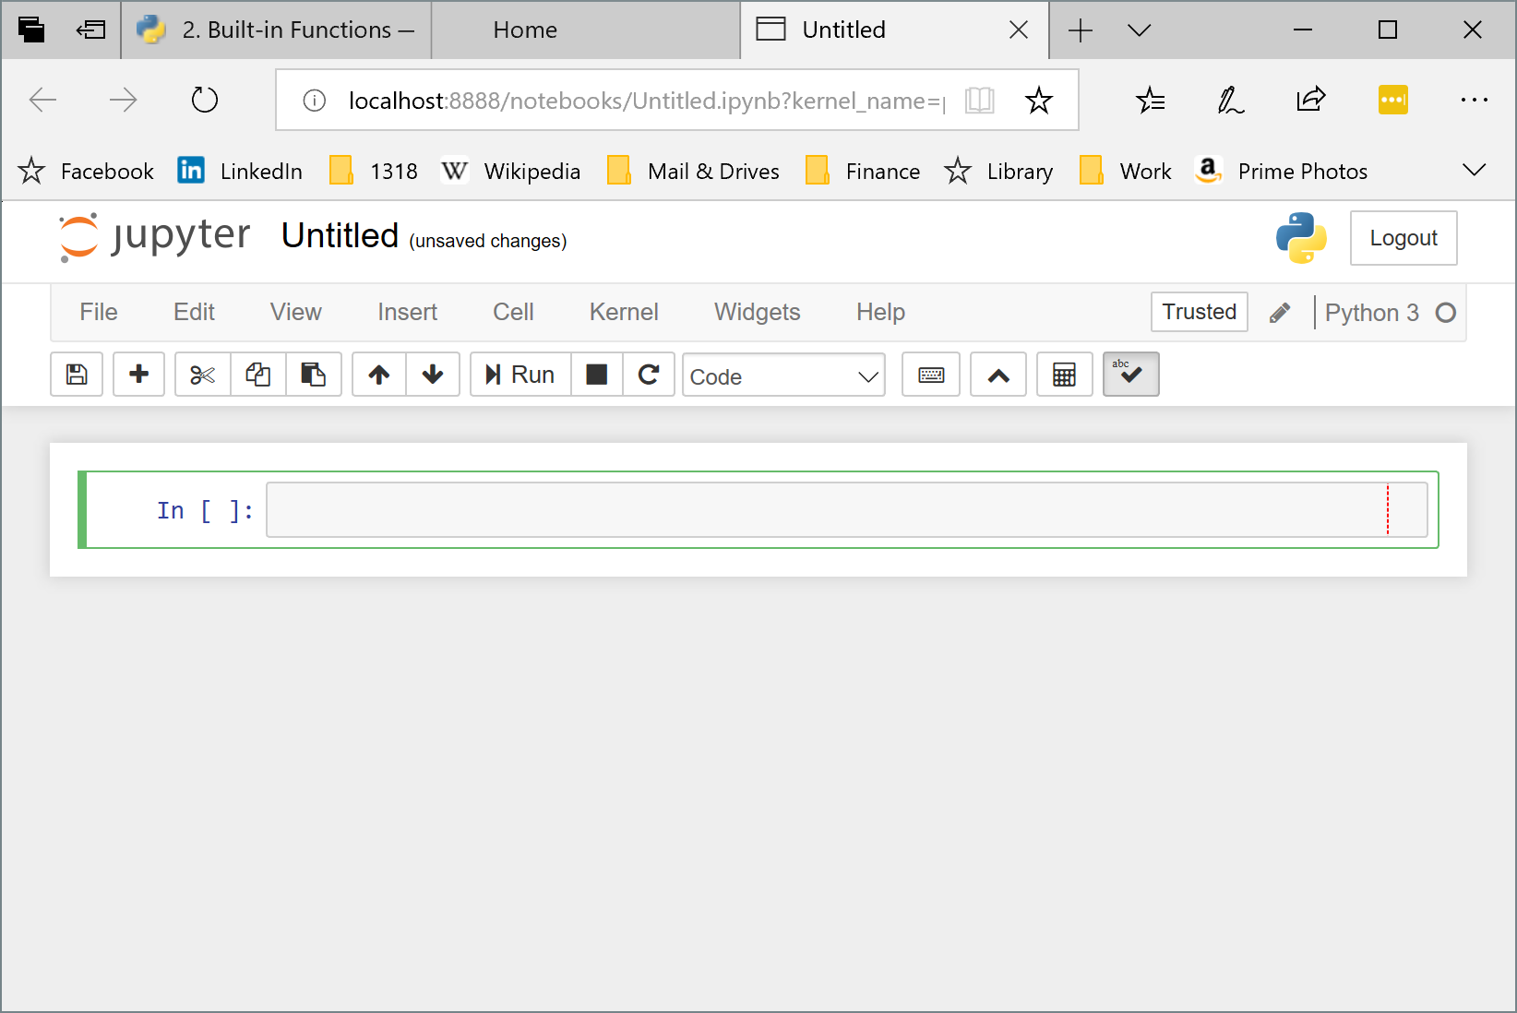
Jupyter Notebooks
In the browser, click New and then Python 3 to create a new notebook with Python 3 code
Type your Python code in the code block (grey box) and hit SHIFT+ENTER to execute the code
The notebook will display the value of the expression on the last line of the code block
Use the notebook to complete this session’s exercises
Refer to the reading assignment to learn how to add cells, delete cells, reorder cells, give the notebook a title, etc.
Click File->Close and Halt when done

Slide 19
JavaScript Object Notation
(JSON)
{"Rankings": [ { "rank": 1, "teamNumber": 2557, "sortOrder1": 3.10, "sortOrder2": 820.00, "sortOrder3": 358.00, "sortOrder4": 2368.00, "sortOrder5": 290.00, "sortOrder6": 0.00, "wins": 7, "losses": 3, "ties": 0, "qualAverage": 379.80, "dq": 0, "matchesPlayed": 10 }, { "rank": 2, "teamNumber": 1806, "sortOrder1": 3.10, "sortOrder2": 745.00, "sortOrder3": 417.00, "sortOrder4": 2676.00, "sortOrder5": 330.00, "sortOrder6": 0.00, "wins": 9, "losses": 1, "ties": 0, "qualAverage": 414.60, "dq": 0, "matchesPlayed": 10}
}
Structured text format used for data exchange on the internet
The IRS scouting system uses JSON to obtain match schedules from the FIRST API and The Blue Alliance
In the session two exercises, we’ll use control statements to extract data from JSON text files
Example JSON from rank_turing_2018.json file

Slide 20
Session 2 Exercises
Use a for loop to calculate the factorial of 1318
Use a while loop to calculate the factorial of 1318
Create a list containing all integers between 0 and 1318 that are multiples of 13 or 18.
Loop through the JSON rankings to find the team with the highest score in sortOrder3

Slide 21
Working with JSON
Insert and run this code at the beginning of your Jupyter notebook to read the JSON file:
import json
rank_file = open("rank_turing_2018.json")
rank_data = json.load(rank_file)
rank_file.close()
rank_data
Use the rank_data variable for the exercises on the next slide

Slide 22
Session 2 Exercises
Analyze the JSON schedule to find all matches with a specific team
Analyze the JSON schedule to find a match where two specified teams play each other
Read the online documentation for the json.load(), open(), and close() functions (for close(), refer to section 16.2 (io) of the Python Standard Library documentation)

Slide 23
Functions, Modules, and Scope
Session 3

Slide 24
Minimize the Cost, Maximize the Value!

